Slide 1
POWER FACTOR CORRECTION

Slide 2
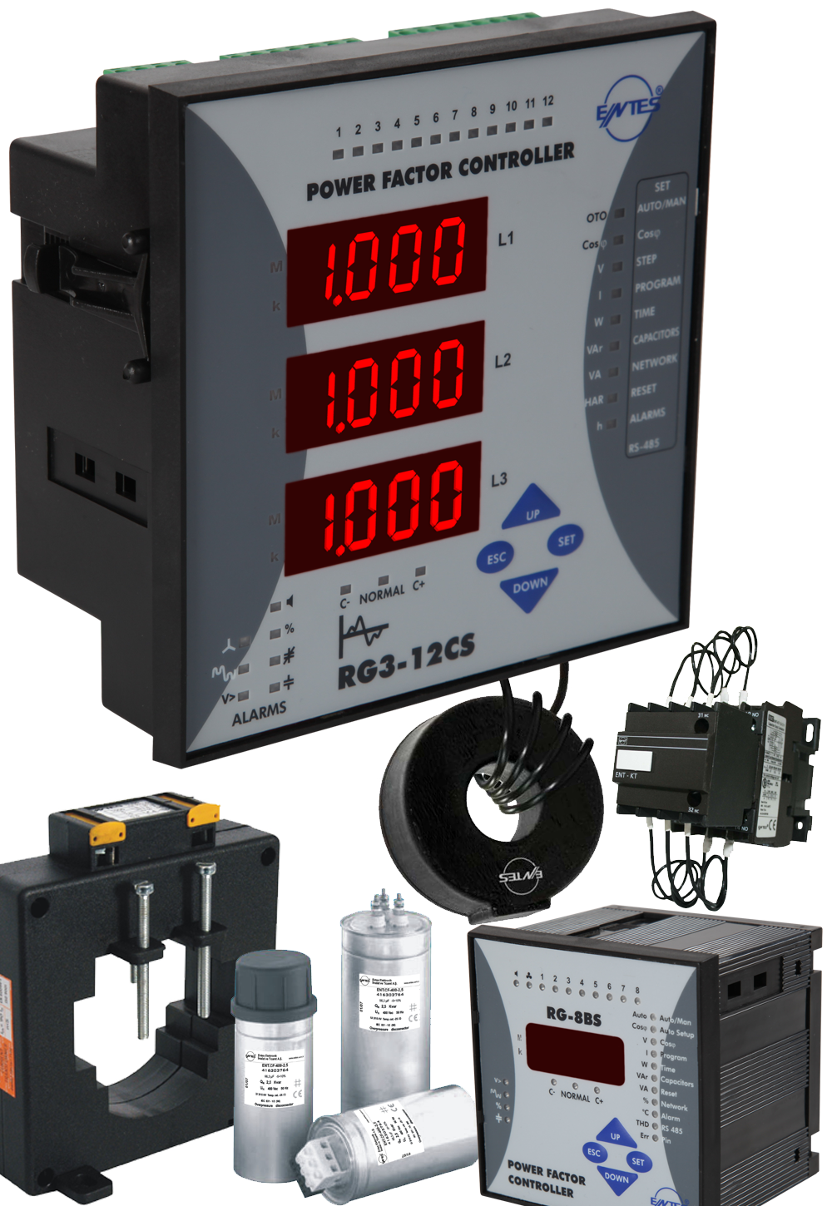
Power Factor Correction
Benefits
Reduced power consumption
Reduced electricity bills
Improved electrical energy efficiency
Reduced transformer and distribution equipment losses
Voltage drop reductions in long cables
Extra kVA availability from the existing supply
Improved starting torque of motors

Slide 3
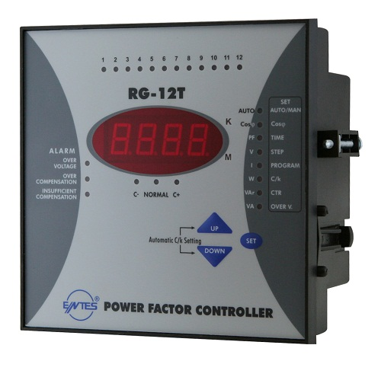
RG-T Series
Features
Single phase measurement
Used in balanced systems
Linear switching
Display of Cosφ, P, Q, S, Urms, Irms
5,6,8 and 12 step options
Degree of protection: IP40 (IP 54 optional)

Slide 4
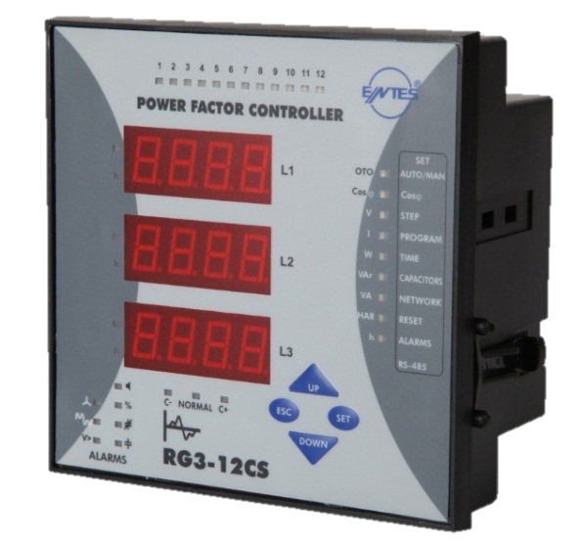
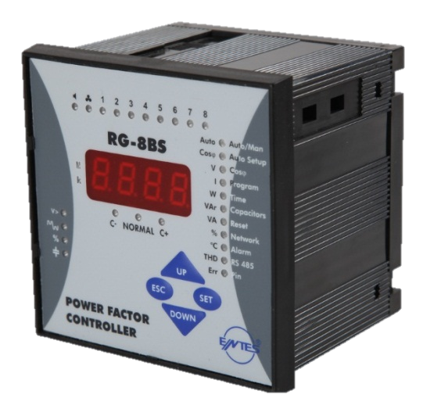
RG-B & RG-3 Series
Features
Single phase measurement for balanced systems (RG-B Series)
Three phase measurement for unbalanced systems (RG3 Series)
Programmable target Cosφ values
Programmable secondary Cosφ for generator supplied operation
Selectable step numbers
Internal and external temperature control (optional)

Slide 5
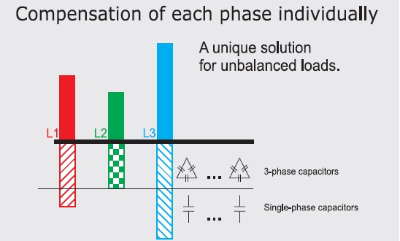
RG-B & RG-3 Series
Features cont’d
10 Different program options for step sequence
Mono-phase capacitor steps (RG3 Series)
Programming the energy counter value as on the system’s energy meter (RG3 Series)
Automatic connection recognition mode (RG3 series)
Programmable energy ratio percent alarm between 1-240 hours.
Internaly detecting and fixing misconnections

Slide 6
RG-B & RG-3 Series
Features
Smart Swithcing
Automatic measurement of each of the capacitor step power values
Activating and deactivating only necessary capacitor steps
During initial setup, switches on&off all the steps by order and saves capacitor values in memory

Slide 7
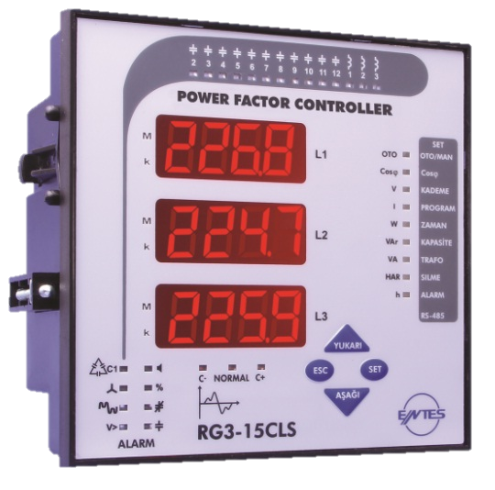
RG3-15CLS
Features
Additional 3 shunt reactor steps
Reactor steps are not recognized automatically.
Auto-connection and auto-setup is done while reactor steps are off.
Relay does not switch on both capacitors and reactors at the same time.Thus, prevents resonance problems.

Slide 8
RG Series
Measured Parameters

Slide 9
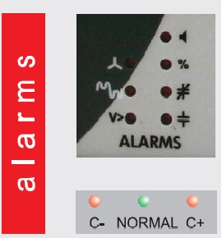
Easy Troubleshooting
Alarms
Harmonic
Temperature
Improper Capacitor
Wrong connection
Insufficient compensation
Over compensation
Over voltage

Slide 10
Communication
RS-485 Modbus RTU communication

Slide 11
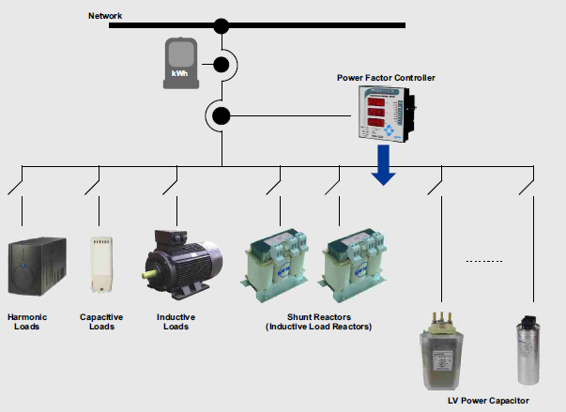
Shunt Reactors
Applications
Inductive load test systems
Large settlement areas (campuses, farmlands, etc.)
Telecommunication stations

Slide 12
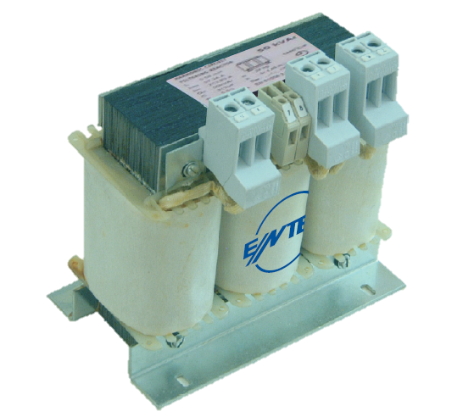
ENT-ERS Series
Features
Single or three phase, high permeable iron core, air gapped design
Suppy voltage: 230V (1~) - 400V (3 ~)
Reactive power range: 0,25- 0,5- 1- 1,5- 2,5 (1~) 0,5- 1- 1,5 -2 -2,5 -3- 5- 7,5- 10- 20- 25- 40- 50 (3~)
Thermal switch for overload protection at each leg
Terminal block, bar or cable connection depending on current value
Vacuum impregnated varnish to ensure silent and moisture-immune operation
CE sign and compatibility with EN 61558 2-20

Slide 13
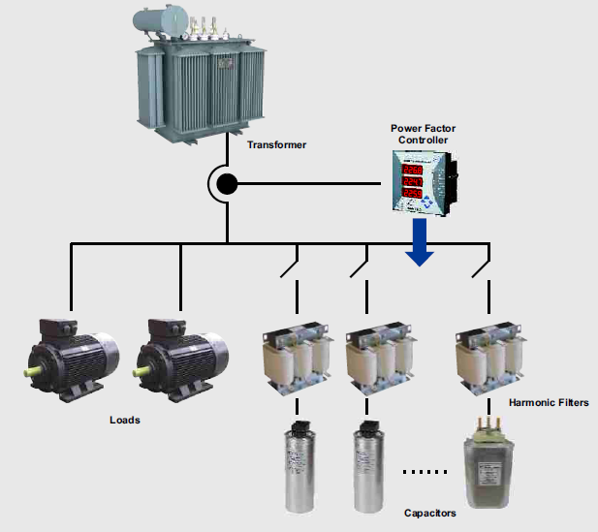
Detuned Filter Reactors
Applications
Hospitals
Airports
Industrial facilities
Speed control equipments
Power factor correction units

Slide 14
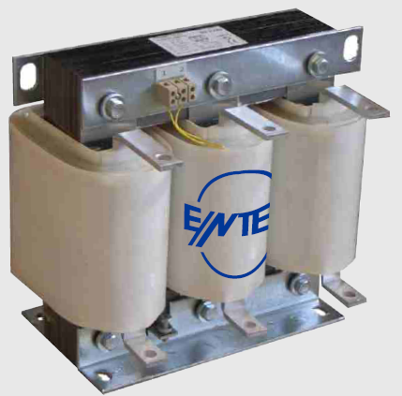
ENT-ERH Series
Benefits
Prevents overcurrents during switching on the capacitor banks
Prevents capacitor bank overload which are created because of the harmonic resonance
Longer capacitor lifetime
Prevents overheating of the utility transmission cables and distribution transformer

Slide 15
ENT-ERH Series
Features
High quality copper or aluminium windings
Available at any resonance frequency
Linearty according to resonance frequency
Reactive power range: (1,5 – 100) kVar
Harmonic loads according to EN 61000-2-2
P(fr) factor | Resonance frequency for 50hz | Minimum capacitor voltage
%5,67 | 210 Hz | 424 V
%7 | 189 Hz | 430 V
%14 | 134 Hz | 465 V

Slide 16
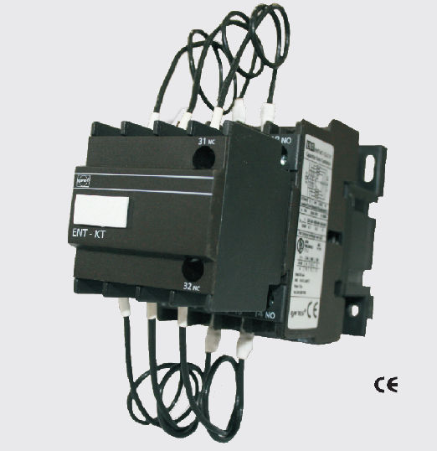
Capacitor Duty Contactors
Benefits
High electrical life
Less maintenance & Down-time
Long electrical life
Reduced power loss during ‘on’ condition
Switching capacitor bank in parallel without de-rating
Features
415 V AC rating
Capacitor range: 10-60 kVar
Electrical life at rated load: 10000-20000 operations (optional)

Slide 17
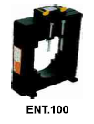
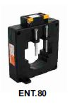
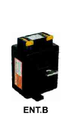
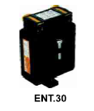
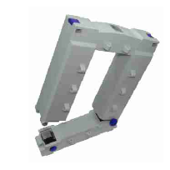
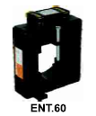
Low Voltage Current Transformers
ENT-Series
Primary Current: 5 – 5000 A (optional)
Nominal Power: 5 – 30 VA (optional)
Class 0,5 (ENT 30 Class 1)
ENS-Series
Split core current transformers
Primary Current: 100 –4000 A (optional)
Nominal Power: 1.25 – 30 VA (optional)
Class 0,5 ( ENS.AYS 23/58 Class 1)
CT-25
Ratio: 1/2500
Class 1

Slide 18
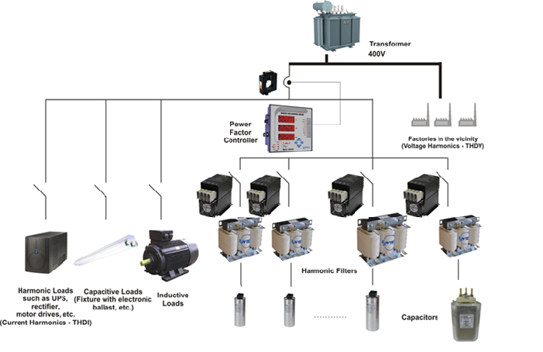
Static Contactors on a System
Appropriate harmonic filter reactors must be used in systems with harmonics.

Slide 19
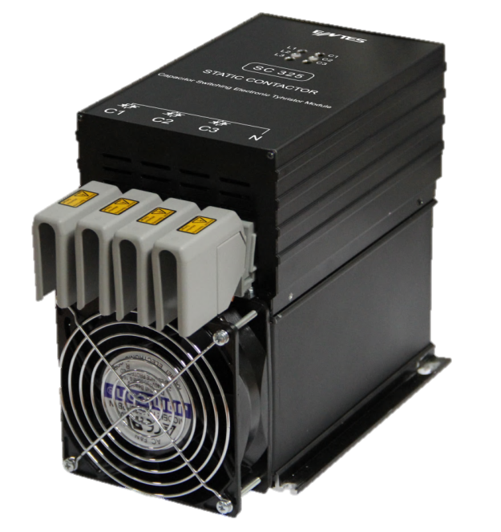
Static Contactors
 | 25 kVAr | 50 kVAr
Triangle with 2 thyristors (400 V) (without fan) | SC-225 | SC-250
Star with 3 thyristors (690 V) (with fan) | SC-325 | SC-350

Slide 20
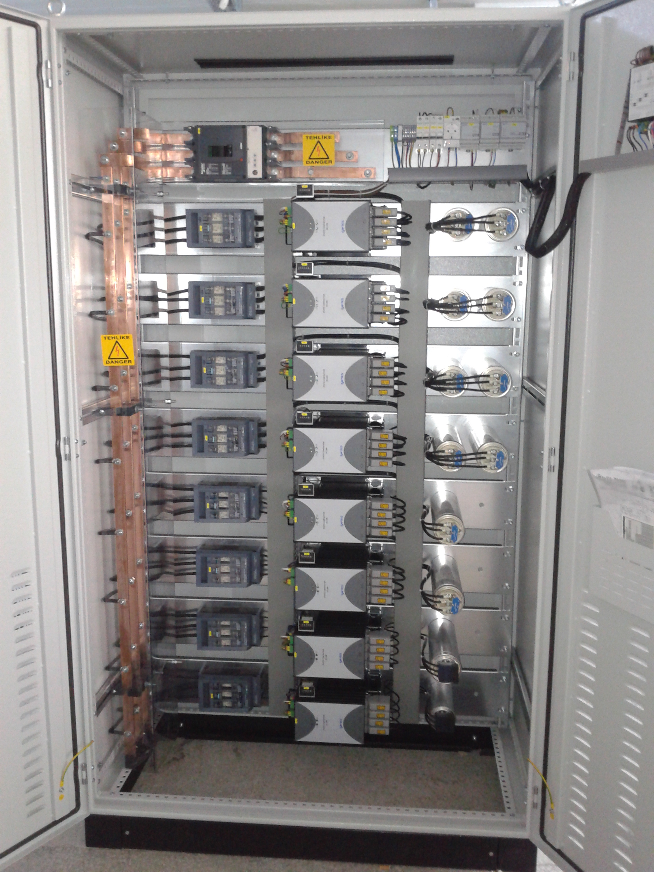
Dimensions and Usage Configuration

Slide 21
Thank You

